Slide 1
Earning Insights a Seat at the Table by Creating Organizational Focus
Michelle Thevil
Director of Consumer Insights
Clif Bar & Company
Notes:
Before I begin, I’m curious
How many of you think your research is as impactful on the organization as you want it to be?
And what are some things that stand in the way?
I’ve been doing this for nearly 20 years, and sometimes I feel like we succeed in having the impact I want. And sometimes, not so much.
So I’ve spent time reflecting on the situations where it’s gone well, and when it hasn’t
I’m going to share with you some things that have worked well for us at Clif Bar.

Slide 2
From Fulfilling Data Requests
To Driving Strategy
Notes:
Flashback to three years ago when I joined Clif Bar.
Insights was fairly new to the organization.
I was the first functional leader they had
We had (and still have) limited resources. Both in terms of people + budget.
We were operating a lot like a MR vendor. Fulfilling requests and handing over data. Usually for very tactical projects.
We weren’t being engaged in strategy discussions.
We weren’t being invited to key meetings.
The brand teams were not sure how and when to leverage us
And we had very little exposure outside of Brand.
Does this sound familiar to any of you?
Have you been or are in a similar situation?
How many of you think your research is as impactful on the organization as you want it to be?
And what are some things that stand in the way? (Leadership buy-in, DR ability, too much/too little data)

Slide 3
Insights Drive Organizational Focus
Notes:
Great Insights people want to be key thought partners in driving strategy.
When we truly harness powerful consumer insights, we can help guide the org forward
And create focus
I’ve been doing this for nearly 20 years, and sometimes I feel like we succeed in having the impact I want. And sometimes, not so much.
So I’ve spent time reflecting on the situations where it’s gone well, and when it hasn’t
I’m going to share with you some things that have worked well for us at Clif Bar.
Hopefully there are a few nuggets in there that you can reapply at your orgs

Slide 4
Insights Drive Organizational Focus
Leverage 1-2 Key Projects
Identify the Right Topics
Start with the Implications
Fine Tune the Message
Socialize It
Notes:
Five elements helped make us successful in growing our influence at Clif Bar
Leverage 1-2 key projects
Identifying the right topics
Starting with the implications
Fine tune the message
And socializing it in the right way
Now let’s go into each of these

Slide 5
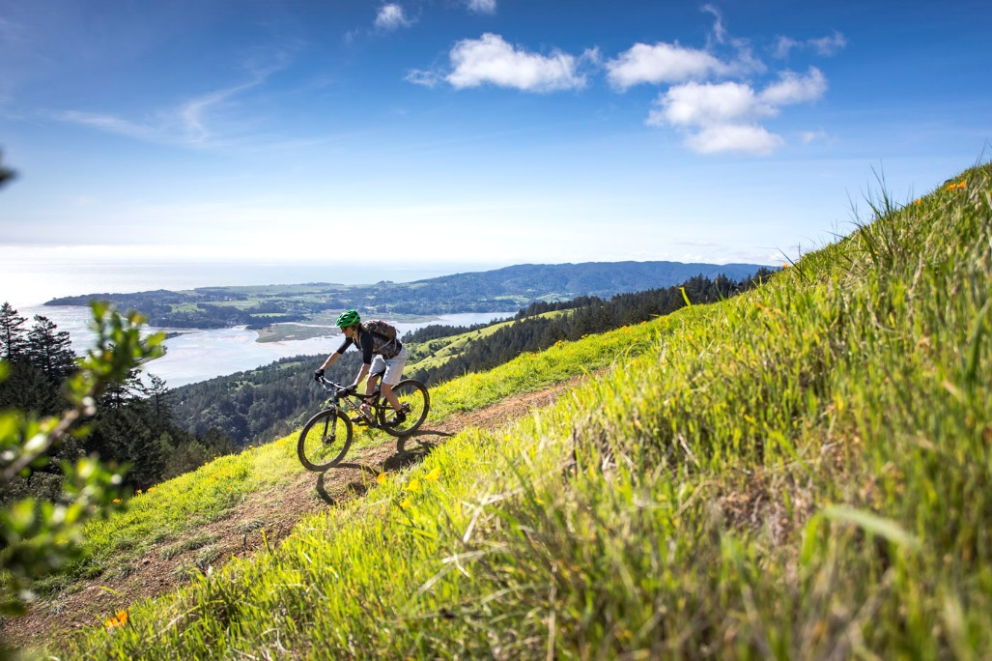
Leverage 1-2 Key Projects
Opportunity for the biggest strategic impact
Opportunity to advance organizational learning the most
Reach the most important stakeholders
Reach the broadest audience
Notes:
The first thing we did at Clif was to identify 1 or 2 key projects that could best showcase the value Insights can play when we operate more strategically.
I knew we would need to demonstrate significantly greater value with the resources we had.
No one is going to give me more money and more people if they don’t understand the value Insights can bring.
So how do we this?
When identifying project, recommend focusing on three filters:
Where is there the opportunity for the biggest strategic impact,
Or opport to advance organizational learning the most
Where can we reach the most important stakeholders
Where can we reach the broadest audience
We leveraged annual business planning
This would allow us to demonstrate thought leadership, have a big impact on strategy and reach key, influential audiences
And it didn’t require add’l resources
We could leverage and repackage existing data

Slide 6
We Leveraged Annual Business Planning
Brand’s Situation Assessment
Strategies
Plans
Annual Research Presentations
Notes:
This is a fairly typical business planning process, even if the language is different.
And previously how Clif was operating.
the Insights team:
Organized a series of detailed research presentations. Usually annual tracking, Nielsen or IRI data, trend data, etc
Followed by an excruciatingly detailed regurgitation of those studies
Then Brand would do Sit Ass or Key Learnings, where they assess the major factors impacting their brand over the next 1-3 years, incorporating a lot of those data points.
We discovered a few problems with this approach:
By trying to summarize all the research details, we weren’t creating focus.
And we weren’t creating important dialogue around the most critical business issues
As the brand teams moved into Sit Ass, each team was left to interpret the strategic implications.
Which resulted in them presenting to the leadership team very different stories of the competitive and consumer landscapes.
And the last problem was that the really fun, strategic (but prob self serving) analysis was being done by Brand not Insights Team

Slide 7
We Leveraged Annual Business Planning
Brand’s Situation Assessment
Strategies
Plans
Consumer Insights’ Key Learnings
Annual Research Presentations
Notes:
To solve for this and to help transition us from data providers to key thought partners,
We created an extra step in the Biz Plan Process before Brand begins their sit ass
A Key Learnings from Consumer Insights
In KL, the goal isn’t to summarize everything, but to make judgement calls about what is most important for the team to know and to be discussing
This is Consumer Insights’ opportunity to set the stage for what key trends, issues, opportunities are important for us to think about across the organization and across brands.
This now kicks off our annual biz planning
It helps bring focus to the rest of the business planning process
It helps level set everyone to ensure a common understanding of the bigger trends impacting all our brands
How many of you do something like this now?

Slide 8
Identify the Right Topics
Build on strategies
Address misinformation
Look further upstream
Raise provocative questions or question sacred cows
Think about problems differently
Notes:
The second thing we did was to identify the right topics
Again, the goal isn’t to summarize everything, but to bring focus to the organizational conversation
Topics that add dimension and clarity to current strategies
For Clif, Adventure is a large part of our brand persona. But we saw an opportunity to help employees better understand and connect to what adventure means to our consumers.
Addressing mis-information or internal confusion
In one such example, it was helping the org understand that consumers were using a competitor for satiety rather muscle performance as is typically the case with high protein bars.
Thirdly, Where can we help the organization look further upstream
What should we know, but don’t?
By illustrating the knowledge gap so we could create demand to fill that gap
Gen Z, Digital- leveraged free syndicated data to wet appetite and illustrate opportunity to learn more
Fourth, raising provocative questions and questioning sacred cows
An EG for us was helping the organization understand that Non-GMO and Organic labeling aren’t redundant to consumers, because 90% don’t know that Organic restricts the use of GMOs.
Lastly, how can we help teams think about problems differently
EG helping the team think through flavor opportunities by illustrating that we had been thinking about two extreme ends, but there was a whole range of flavors that fall in between.

Slide 9
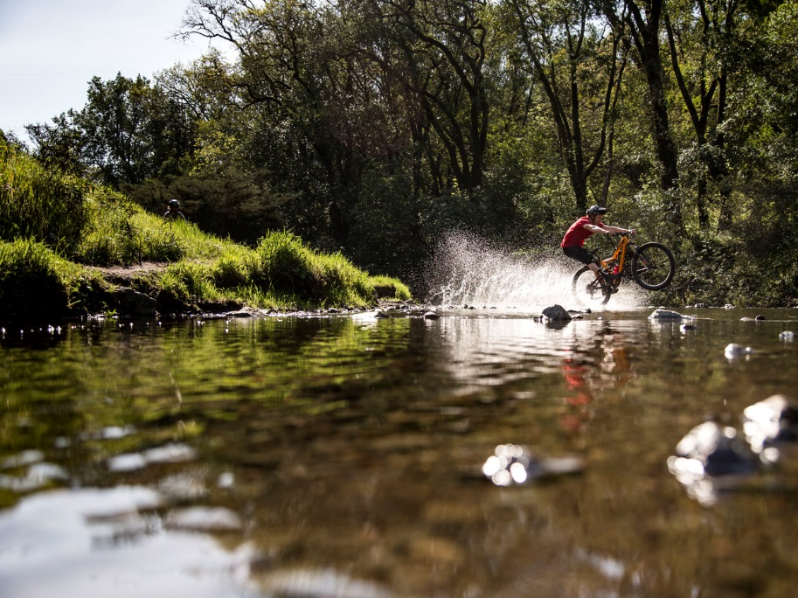
Start with the Implications
Then figure out how to show the data to support it.
Notes:
After the first year of doing our KL, I heard from several that it was the last two page summary that they kept returning to during biz planning.
So now I start with those pages
What are the big so-what’s? What do I want them to walk away knowing and taking action on? What does org need to know about our consumers in order to shape strategies and tactics?
Then I think about what data best illustrates that, and build the story to support it.
This sounds simple, but it was the single best thing I’ve done.
Doing this will help you focus on big picture strategy vs getting bogged down in minutia.
It made distilling a year’s worth of data much simpler, saving me valuable time
More impactful, bringing greater value to our stakeholders
I understand that this may be non-traditional for many researchers.
But The organization needs us to be ruthless editors. They don’t have time to sift through hundreds of pages.
I believe it’s Insight’s role to help the org see the forest through the trees.
By bringing focus and clarity, we can help drive alignment and decision making. And we build our influence
When we build influence with the organization, they trust us to deliver a quick guide to what they should do.

Slide 10
Fine Tune the Message
Dig into the cause of resistance to a recommendation.
Be cognizant of how words play out on paper.
Notes:
To build and maintain influence, it’s extremely important to make sure we get the message exactly right
That if the organization acts, they act in the right way
So as you start drafting your business implications, slow down. Slow down and fine tune the message, key takeaways and implications.
I know it can be hard to do this with deadlines looming.
But I’ve found that it’s worth building in extra time at the end to fine tune the message.
It pays dividends in driving alignment and creating a common understanding.
We need to bring decision makers along, so they have skin in the game.
Fine tuning the message requires two things
1) shop around more controversial biz implications to help crystalize the final articulation
Really dig into and listen to what’s causing hesitation
2) Being very cognizant of how the words can play out when you’re not in the room
I’ve been surprised at how one bullet point, which was so clear in my head, was taken in many different directions when just read on paper.
Earlier I gave my Non GMO and Organic example
I knew both organic and non gmo important to consumers. But every time, I met resistance.
Not until I started listening to what was causing the resistance, did I understand the best way to articulate the consumer need.
It wasn’t didn’t think it was important. Did.
But as a company we felt very strongly about supporting Organic, and the concern was that Non-GMO further confused the meaning of organic. Because Organic certification already restricts the use of GMOs
Knowing this, shifted my message to show that 90% of people don’t know that Organic labeling includes non-gmo. This made my message much more impactful internally, and we finally started seeing action to include Non GMO and Organic messaging on pack.

Slide 11
Socialize It
Brand Team
Leadership Team
Department Heads
Sales
Company Wide
Notes:
Once we have this great piece of Insights work, how do we roll it out and get in front of as many people as possible?
How you do this will certainly depend on the project and on your organizational culture.
Here’s what we do at Clif
I’m guessing the first two are fairly typical, but many of you may not be doing the following three.
Start with the brand team, who sees the most detailed presentation. 1:30- 2 hours
The leadership team quickly follows with a slightly distilled version. 1- 1:30 hours
Experimented with LT first and Brand second, but the bottom up approach rather than top down felt more right for our organization
We then share with the department heads. And we do this in combination with Brand
We start with about a 20-30 min recap of CI KL, followed by a summary of each Brand’s SitAss.
This really helps the x func team understand how the consumer helps drive our strategies
Then we will role out to other teams. Sales at the Sales Meeting. Lastly a Co wide share out for anyone who is interested
While it might not seem efficient, it does create efficiencies in driving alignment and ensuring we are all on the same page.
I found this to be most effective at driving organizational understanding and ensuring the right conversations happened
It ensures that each team sees the level of detail that’s right for them
It also ensures the right discussions happen.
When too many people are in the room. Junior people don’t ask questions. Senior leaders don’t want to ‘think out loud’ on tough questions

Slide 12
The Impact
Greater demand for research
Opinion valued outside of just data
Increased involvement in strategy discussions
Increased organizational excitement
Notes:
So what’s been the impact on us at Clif?
this has resulted in seeing
A greater demand for research, across levels and dept
And increased demand for our opinion, not just data.
Being invited to key meetings that we have not been in the past
And greater organizational excitement to learn about the consumer. Teams have included us as part of standard onboarding. Teams have invited us to their team meetings to learn more about the consumer and what we do. Some teams have even asked for quarterly meeting to share new relevant topics.
And perhaps the greatest testament to the impact we’re having is that my manager, quite regularly, reminds of the influence we have.
She cautions me… “I don’t know if you’re aware of the influence you have. When you say something the organization responds”
And I try to look serious and not smile too much
But that feels really good.
It’s extremely rewarding to see Insights being viewed as a valued resource across the organization. To get to help shape the strategy and direction of a brand I Love. It’s so fun and rewarding to see the progress we’ve made at Clif Bar.

Slide 13
Persuasiveness
+
Perseverance
Notes:
But we’re also not done. We’re not exactly where I want us to be. And this is my last bit of advice.
beyond the tools we discussed, growing the Department’s influence also requires two personal traits from you
Persuasiveness + perseverance
You’ll need these 2 to succeed and push through obstacles.
I’ve learned that you can’t make the organization move faster than the org wants to move.
So I’ve had to consistently nudge it in the right direction
Articulating and rearticulating messages
Persistently showing the value Insights can bring
Taking ‘no’s’ in stride and playing the long game

Slide 14
Thank You!
Michelle Thevil
Director of Consumer Insights
Clif Bar & Company
Notes:
Again, when we truly harness powerful consumer insights, we can help guide the org forward
Hope there are a few nuggets you can take back to your organizations to help you increase the impact you have on your org

